Slide 1
Naut’sa mawt
Tribal Council
Best Practices for Returning to Work and Reopening Workplaces – Part 2
Webinar # 9
June 2, 2020

Slide 2
Best Practices for Returning to Work and Reopening Workplaces
If you have any questions about this webinar please text them into the Zoom chat
Any attachments I refer to will available on the Naut’sa Mawt website after the webinar

Slide 3
Agenda for Part 2 of this Webinar:
Steps to develop a COVID-19 Safety Plan continued…
Step 2B – 4 Level Protocol Plan to reduce the risk of person-person
transmission
Step 3 – Develop policies
Step 4 – Develop communication plans and training
Best Practices for Returning to Work and Reopening Workplaces

Slide 4
Agenda for Part 2 of this Webinar:
Steps to develop a COVID-19 Safety Plan continued…
Step 5 – Monitor workplace and update plans as necessary
Step 6 – Assess and address risks from resuming operations
Best Practices for Returning to Work and Reopening Workplaces

Slide 5
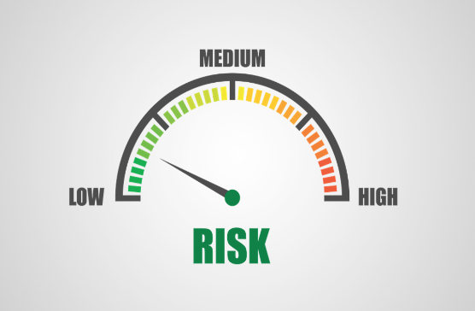
Step 2B - Implementing Protocols to Reduce the Risks of Person-to-Person Transmission
4 Levels of Protocols
Level 1 – Elimination
Level 2 – Engineering Controls
Level 3 – Administrative Controls
Level 4 – Personal Protective Equipment (PPE)
Best Practices for Returning to Work and Reopening Workplaces

Slide 6
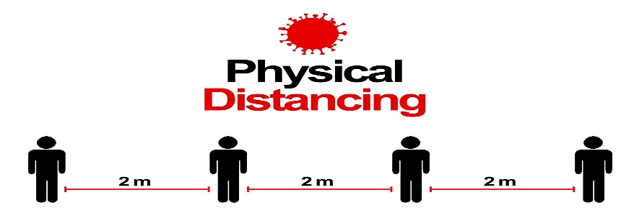
Step 2B – Implementing Protocols to Reduce the Risks of Person-to-Person Transmission
Level 1 – Elimination
Limits people in the workplace
Uses Policies and Procedures
Rearrange work spaces
An attachment entitled “Building/Room Occupancy Level sign” will be available after the webinar

Slide 7
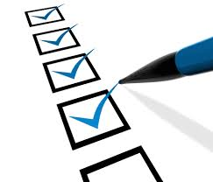
Step 2B - Implementing Protocols to Reduce the Risks of Person-to-Person Transmission – Level 1 (Elimination)
Level 1 Checklist and Control Measures
✓ Established and posted an occupancy limit
for our premises
✓ Considered alternative work arrangements
✓ Established and posted occupancy limits for
common areas
✓ Implemented physical distancing measures
Best Practices for Returning to Work and Reopening Workplaces

Slide 8
Step 2B - Implementing Protocols to Reduce the Risks of Person-to-Person Transmission – Level 1 (Elimination)
Level 1 Control Measures In Place
List the identified control measures for
maintaining physical distance in the
workplace
An attachment entitled “4 Level Protocol Plan – Level 1 Checklist and Control Measures” will be available after the webinar
Best Practices for Returning to Work and Reopening Workplaces

Slide 9
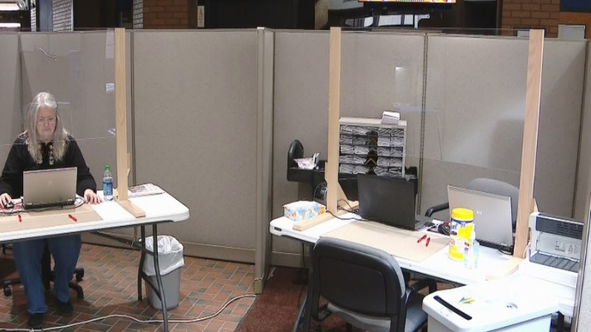
Step 2B - Implementing Protocols to Reduce the Risks of Person-to-Person Transmission
Level 2 – Engineering
Barrier Installation
An attachment entitled “Designing Effective Barriers” will be available after the webinar
Best Practices for Returning to Work and Reopening Workplaces

Slide 10
Step 2B - Implementing Protocols to Reduce the Risks of Person-to-Person Transmission – Level 2 (Engineering)
Level 2 Checklist and Control Measures
✓ Installed barriers where workers can’t keep
physically distant from co-workers or visitors
✓ Included barrier cleaning in our cleaning
protocols
✓ Installed barriers to avoid risk to employees
Best Practices for Returning to Work and Reopening Workplaces

Slide 11
Step 2B - Implementing Protocols to Reduce the Risks of Person-to-Person Transmission – Level 2 (Engineering)
Level 2 Control Measures In Place
Describe how barriers or partitions will be
used in your workplace
An attachment entitled “4 Level Protocol Plan – Level 2 Checklist and Control Measures” will be available after the webinar
Best Practices for Returning to Work and Reopening Workplaces

Slide 12
Step 2B - Implementing Protocols to Reduce the Risks of Person-to-Person Transmission
Level 3 – Administrative Controls
Establish rules and guidelines
Best Practices for Returning to Work and Reopening Workplaces

Slide 13
Step 2B - Implementing Protocols to Reduce the Risks of Person-to-Person Transmission – Level 3 (Administrative Controls)
Level 3 Checklist and Control Measures
✓ Identified rules and guidelines
✓ Communicated these rules and guidelines
Best Practices for Returning to Work and Reopening Workplaces

Slide 14
Step 2B - Implementing Protocols to Reduce the Risks of Person-to-Person Transmission – Level 3 (Administrative Controls)
Level 3 Control Measures In Place
List the rules and guidelines
An attachment entitled “4 Level Protocol Plan – Level 3 Checklist and Control Measures” will be available after the webinar
Best Practices for Returning to Work and Reopening Workplaces

Slide 15
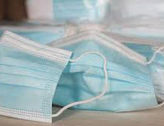
Step 2B - Implementing Protocols to Reduce the Risks of Person-to-Person Transmission
Level 4 – PPE
When to consider the use of non-medical masks
Attachments entitled “Selecting a Mask” and ”How to Use a Mask” will be available after the webinar
Best Practices for Returning to Work and Reopening Workplaces

Slide 16
Step 2B - Implementing Protocols to Reduce the Risks of Person-to-Person Transmission – Level 4 (PPE)
Level 4 Checklist and Control Measures
✓ Reviewed information on selecting and using
masks
✓ Understand limitations on masks
✓ Trained employees on mask usage
Best Practices for Returning to Work and Reopening Workplaces

Slide 17
Step 2B - Implementing Protocols to Reduce the Risks of Person-to-Person Transmission – Level 4 (PPE)
Level 4 Control Measures in Place
✓ Who
✓ What
✓ How
An attachment entitled “4 Level Protocol Plan – Level 4 Checklist and Control Measures” will be available after the webinar
Best Practices for Returning to Work and Reopening Workplaces

Slide 18
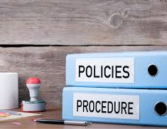
Step 3 – Develop Policies
Policies Should Include:
When are employees or visitors prohibited from your workplace
Providing additional protocols to first aid attendants
Implement additional policies
Best Practices for Returning to Work and Reopening Workplaces

Slide 19
Step 3 – Develop Policies
Policies Should Include:
Training and strategies to address risk of violence in the workplace and implementation of violence prevention programs
Steps to take if employees become ill at work
Best Practices for Returning to Work and Reopening Workplaces

Slide 20
Step 4 – Develop Communication Plans and Training
Plans Should Include:
Educate employees and visitors
Develop and deliver the training plan
Distribute policies
Post signage
Best Practices for Returning to Work and Reopening Workplaces

Slide 21
Step 4 – Develop Communication Plans and Training
The following attachments will be posted on the Naut’sa mawt Tribal Council website after the webinar:
Coughing and Sneezing Etiquette
Handwashing Technique
Building/Room Occupancy Limits
Entry Check for Employees and Visitors
Best Practices for Returning to Work and Reopening Workplaces

Slide 22
Step 5 – MONITOR YOUR WORKPLACE & UPDATE YOUR PLANS AS NECESSARY
Update policies and procedures
Plan to monitor risk
Involve others to resolve safety issues

Slide 23
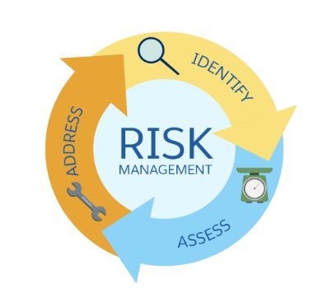
Step 6 – Assess and Address Risks From Resuming Operations
Develop, Revise, or Review:
Training plans
Start-up requirements
Best Practices for Returning to Work and Reopening Workplaces

Slide 24
This concludes Part 2 of the webinar
Thank you for attending the Return to Work and Reopening Workplaces webinars
If you missed Part 1 of this webinar, it is available on the Naut’sa mawt Tribal Council website
If you have any questions about Parts 1 or 2 of this webinar, please text them into the Zoom chat or email COVID19@nautsamawt.org
Thank you and enjoy the rest of your day

Slide 25
More Information
For more information on re-opening your facilities, please visit the returning to work section in the Naut’sa Mawt web site at:
https://www.nautsamawt.org/returningtowork

Slide 26
Key Contact Info
NmTC Support
covid19@nautsamawt.com
https://www.nautsamawt.org/covid19-resources
https://www.nautsamawt.org/returningtowork
EMBC Vancouver Island Region 1-250-952-4900
EMBC South West Region 1-778-572-3962
Indigenous Services Canada 1-604-209-9709

