Slide 1
Naut’sa mawt
Tribal Council
Best Practices for Returning to Work and Reopening Workplaces
Webinar # 8
May 28, 2020

Slide 2
Agenda for Part 1 of this Webinar:
Purpose and outcomes of the webinar
Discussion about worker safety
Identifying the 6 Steps to develop a COVID-19 Safety Plan
Best Practices for Returning to Work and Reopening Workplaces

Slide 3
Agenda for Part 1 of this Webinar:
Delving into:
Step 1 - Conducting a Risk Assessment, and
Step 2A – Implementing Protocols for Offices
If you have any questions about Part 1 of this webinar please text them into the Zoom chat. Any attachments I refer to are available at the end of the webinar slides.
Best Practices for Returning to Work and Reopening Workplaces

Slide 4
Purpose and Outcomes of the Webinar
History behind the necessity for Safety Plans
Understanding of issues related to and components of a Safety Plan
Take away guidance and tools to develop a Safety Plan

Slide 5
Discussion About Worker Safety
Employer obligations
Employee refusal of unsafe work
Consequences for failure or refusal to comply with the COVID-19 Safety Plan

Slide 6
Discussion About Worker Safety
Response to a positive diagnosis
WorkSafeBC requirements around COVID-19
COVID-19 Safety Plan

Slide 7
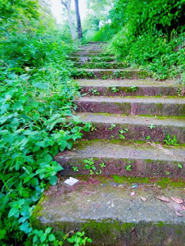
Identifying the 6 Steps to Develop a COVID-19 Safety Plan
Step 1 - Conducting a risk assessment
Step 2 – (2A & 2B) Implementing protocols to reduce risk
Step 3: Develop policies
Step 4: Develop communication plans and training
Step 5: Monitor workplace and update plans as necessary
Step 6: Assess and address risks from resuming operations

Slide 8
Identifying the 6 Steps to Develop a COVID-19 Safety Plan
Delving into:
Step 1 - Conducting a Risk Assessment, and
Step 2A – Implementing Protocols for Offices

Slide 9
Step 1 - Conducting a Risk Assessment, and
Identify decision makers, Pandemic Liaison and Safety Plan team
Understand risks associated with:
Person-to-person transmission
Surface transmission
Common/shared tools and equipment transmission

Slide 10
5 steps to a Risk Assessment:
Step 1: Identify the hazards
Step 2: Decide who might be harmed and how
Step 3: Evaluate the risks and decide on precautions
Step 4: Record your findings and implement them
Step 5: Review your risk assessment and update if necessary

Slide 11
Considerations:
✓ When to reopen
✓ Recalling employees
✓ Show/who to recall first

Slide 12
Step 2A – Implementing Protocols for Offices
Building access
Workplace Operations
Workstations
Communal spaces

Slide 13
Step 2A – Implementing Protocols for Offices
Outside visitors
Deliveries
Transportation
Elevator use

Slide 14
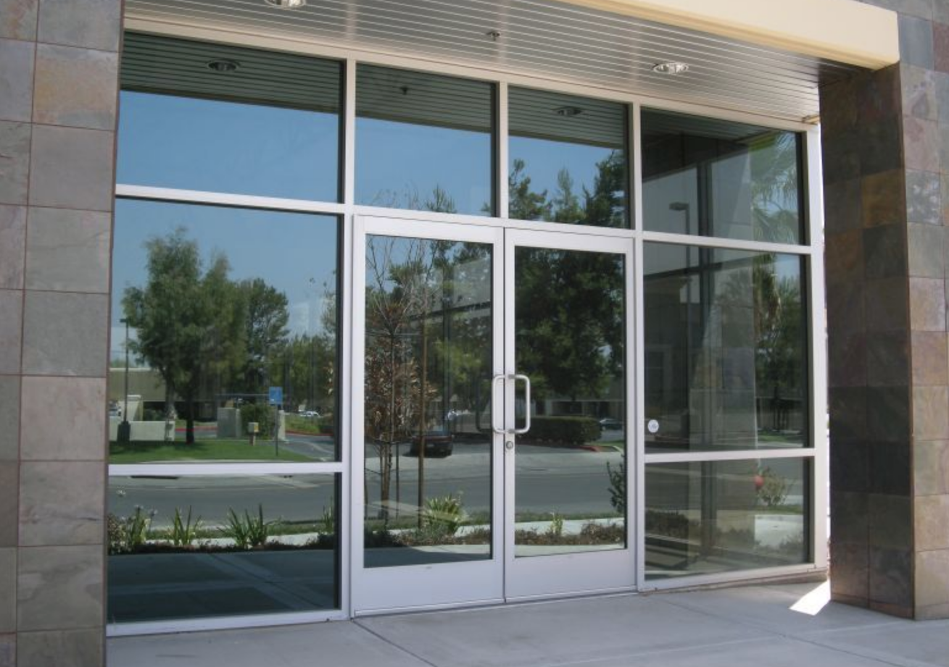
Office Protocols – Building Access
Considerations:
✓ Stagger start and end times
✓ Track office occupancy
✓ Designated entry and exit doors

Slide 15
Office Protocols – Building Access
Considerations:
✓ Hand sanitizer at building entry
area
✓ Post signage regarding sick
employee or visitors
✓ Post signage outside building entry
area regarding building
occupancy, social distancing etc.

Slide 16
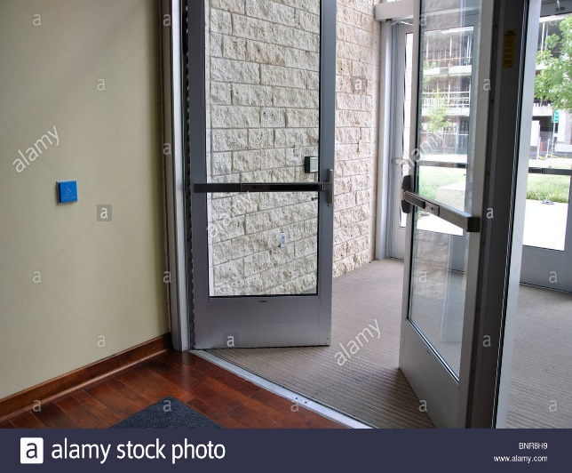
Office Protocols – Building Access
Considerations:
✓ Post signage regarding coughing and sneezing etiquette and
handwashing technique
✓ Tape or mark floors for safe places to stand or for one way halls

Slide 17
Office Protocols – Workplace Operations
Avoid meetings or gatherings where physical distances cannot be maintained
Send sick employees home

Slide 18
Office Protocols – Workplace Operations
Considerations:
✓ Remote work options
✓ Improving videoconferencing
equipment/remote networking capacity
✓ Alternating and/or adding additional shifts

Slide 19
Office Protocols – Workplace Operations
Considerations:
✓ Creating groups of workers who work
together and who do not interact with other
groups
✓ Establishing one-way staircases or hallways
✓ Separating receptionists and others that
directly interact with visitors

Slide 20
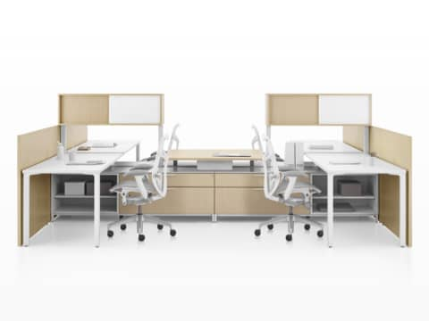
Office Protocols – Workstations
Considerations:
✓ Positioning workers that allows them to put
more distance between themselves and their
co-workers
✓ Making communal pathways one directional
✓ Installing effective barrier

Slide 21
Office Protocols – Workstations
Considerations:
✓ Canceling in-person meetings
✓ Minimizing sharing office space or workstations
✓ Hand sanitizer and disinfectant wipes at each
workstation

Slide 22
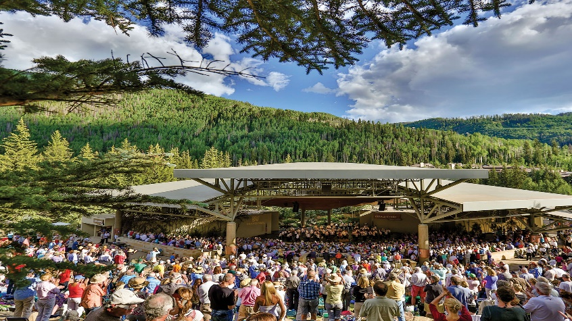
Office Protocols – Communal Spaces
Communicate changes to communal areas
Limit common areas usage
Encourage employees to eat outside or at their desk

Slide 23
Office Protocols – Communal Spaces
Ensure that time spent in close proximity is minimized
Restrict eating to a clearly identified and dedicated area
Require employees to bring their own dishes and utensils

Slide 24
Office Protocols – Communal Spaces
Refrain from providing and consuming communal foods
Keep communal doors to remain open
Instruct employees to use their own equipment

Slide 25
Office Protocols – Communal Spaces
Minimize the number of people using previously shared office equipment
Shared equipment should be cleaned and disinfected after each use
Establish hygiene practices after coming into contact with public items (sample handwashing techniques poster is attached at the end of this webinar)

Slide 26
Office Protocols – Communal Spaces
Reduce washroom occupancy
Staff rooms may need to be altered or closed, or break times staggered
Ensure any measures taken comply with safety and security concerns, fire code regulations etc.

Slide 27
Office Protocols – Communal Spaces
Considerations:
✓ Single-person access if entry into
constricted area is required
✓ Staggered break times and locations
✓ Distance lunch room tables, or installing
plexiglass dividers at the tables

Slide 28
Office Protocols – Communal Spaces
Considerations:
✓ Limiting or controlling third-party access to
the physical workplace
✓ Requirements imposed on third parties
present in the workplace

Slide 29
Office Protocols – Communal Spaces
Considerations:
✓ Steps to clean and disinfect frequent
touchpoints
✓ Steps to ensure that common equipment
remain clean and disinfected

Slide 30
Office Protocols – Communal Spaces
Considerations:
✓ If common equipment will remain in use,
be temporarily removed or shut off
✓ Closing or restricting common areas or
removing furniture to limit occupancy

Slide 31
Office Protocols – Outside Visitors
Prearrange workplace visits. Keep a record of visitors to the workplace
Post signage at the workplace to inform everyone of the measures in place
Remind visitors when to reschedule

Slide 32
Office Protocols – Outside Visitors
Minimize non-essential interaction
Maintain physical distancing in waiting areas
Provide visitor-facing staff with hand sanitizer for their use only
Visitors should attend appointments alone and minimize time spent in waiting area

Slide 33
Office Protocols – Deliveries
Identify delivery zones
Drop off goods at delivery zone
Request contactless delivery

Slide 34
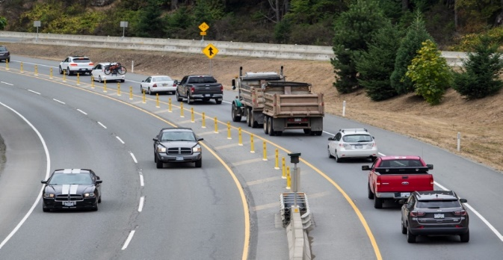
Office Protocols – Transportation
Limit travel to critical business functions
Minimize the use of shared vehicles
Use other means of communications
Follow protocols for transporting clients

Slide 35
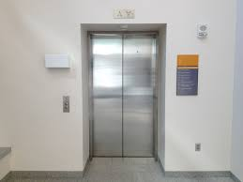
Office Protocols – Elevator Use
Post occupancy limits
Indicate where workers and visitors should stand
Disinfect elevator panels

Slide 36
Thank You
The Agenda for Part 2 will include:
Steps to develop a COVID-19 Safety Plan continued…....
Step 2B – 4 Level Protocol Plan to reduce the risk of person-to-person transmission
Step 3 – Develop policies
Step 4 – Develop communication plans and training
Step 5 – Monitor workplace and update plans as necessary
Step 6 – Assess and address risks from resuming operations
If you have any questions about Part 1 of this webinar please text them into the Zoom chat

